Slide 1
Adaptive Learning Rate
Instructor: Dr. Yan Yan

Slide 2
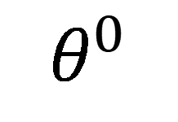
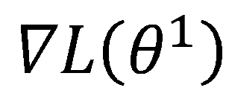


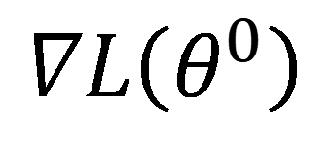

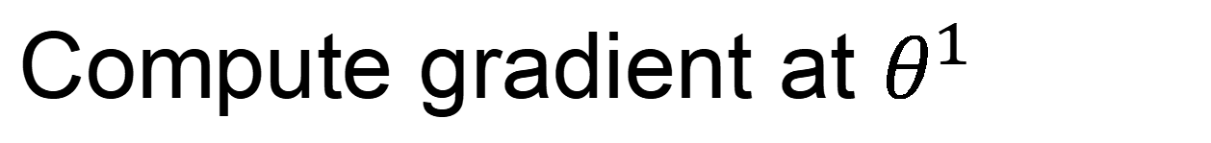
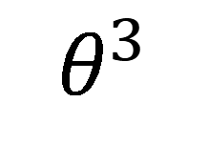
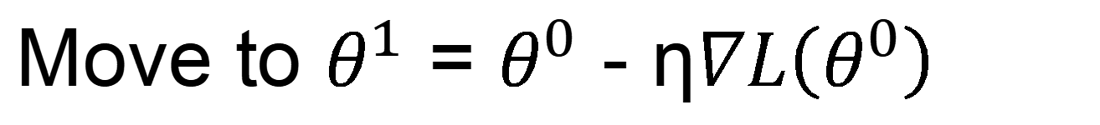
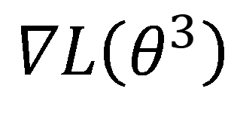
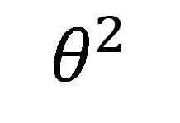
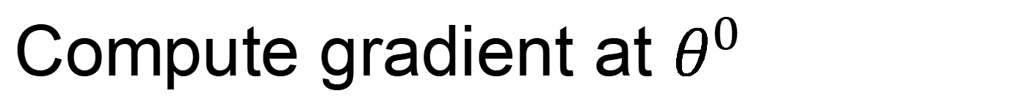
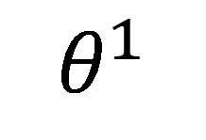
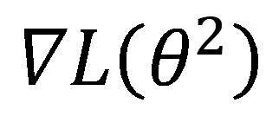
Review: Vanilla Gradient Descent
$$∇L\left(θ^{0}\right)$$
Start at position $θ^{0}$
$$∇L\left(θ^{1}\right)$$
Compute gradient at $θ^{0}$
$$θ^{0}$$
$$θ^{1}$$
Move to $θ^{1}$ = $θ^{0}$ - η$∇L\left(θ^{0}\right)$
$$∇L\left(θ^{2}\right)$$
Compute gradient at $θ^{1}$
$$θ^{2}$$
Gradient
Move to $θ^{2}$ = $θ^{1}$ – η$∇L\left(θ^{1}\right)$
Movement
$$∇L\left(θ^{3}\right)$$
$$θ^{3}$$
……
Stop until $∇L\left(θ^{t}\right)≈0$

Slide 3
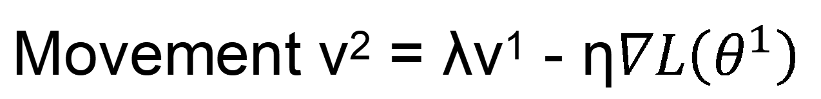
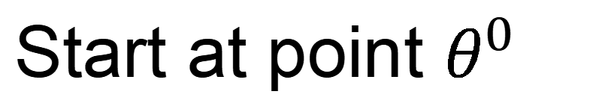
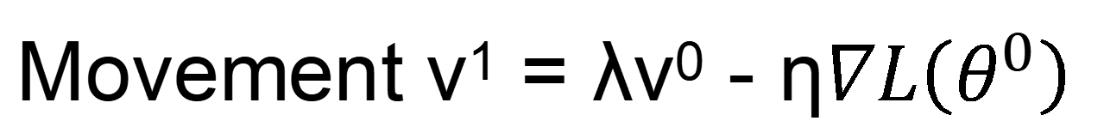

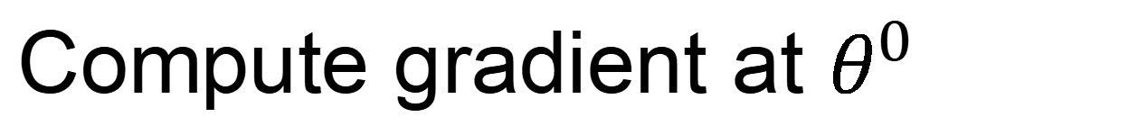
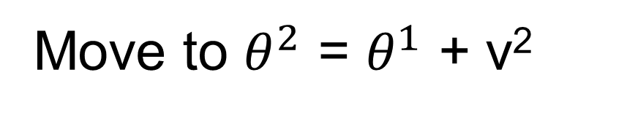
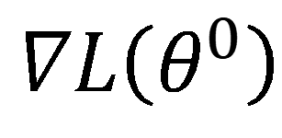
Momentum
Movement: movement of last step minus gradient at present
Start at point $θ^{0}$
Movement v⁰=0
$$∇L\left(θ^{0}\right)$$
Compute gradient at $θ^{0}$
$$∇L\left(θ^{1}\right)$$
$$θ^{0}$$
Movement v¹ = λv⁰ - η$∇L\left(θ^{0}\right)$
$$θ^{1}$$
Move to $θ^{1}$ = $θ^{0}$ + v¹
$$∇L\left(θ^{2}\right)$$
Compute gradient at $θ^{1}$
$$θ^{2}$$
Gradient
Movement v² = λv¹ - η$∇L\left(θ^{1}\right)$
Movement
Move to $θ^{2}$ = $θ^{1}$ + v²
$$θ^{3}$$
$$∇L\left(θ^{3}\right)$$
Movement
of last step
Movement not just based on gradient, but previous movement.

Slide 4
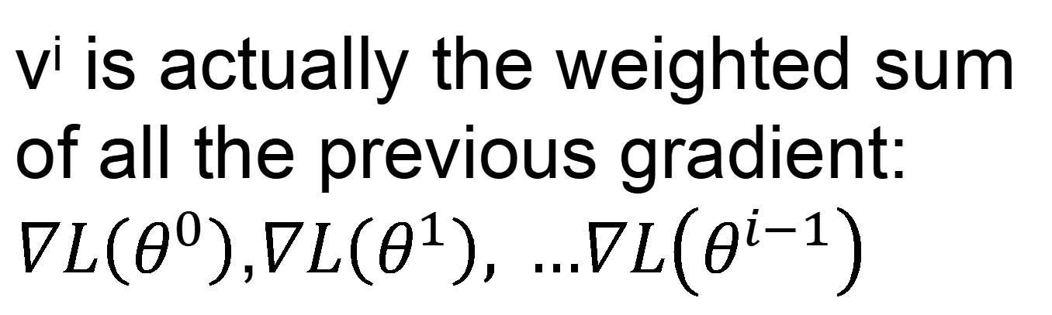

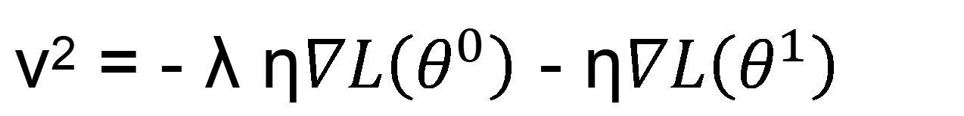
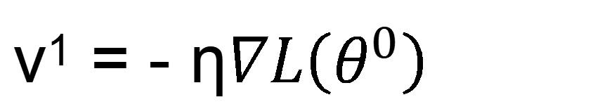
Momentum
Movement: movement of last step minus gradient at present
Start at point $θ^{0}$
Movement v⁰=0
Compute gradient at $θ^{0}$
v^{i} is actually the weighted sum of all the previous gradient: $∇L\left(θ^{0}\right)$,$∇L\left(θ^{1}\right), …∇L\left(θ^{i−1}\right)$
Movement v¹ = λv⁰ - η$∇L\left(θ^{0}\right)$
Move to $θ^{1}$ = $θ^{0}$ + v¹
v⁰ = 0
Compute gradient at $θ^{1}$
v¹ = - η$∇L\left(θ^{0}\right)$
Movement v² = λv¹ - η$∇L\left(θ^{1}\right)$
Move to $θ^{2}$ = $θ^{1}$ + v²
v² = - λ η$∇L\left(θ^{0}\right)$ - η$∇L\left(θ^{1}\right)$
Movement not just based on gradient, but previous movement.
……

Slide 5

Momentum
Still not guarantee reaching global minima, but give some hope ……
cost
Movement =
Negative of 𝜕𝐿∕𝜕𝑤 + Momentum
Negative of $∂L∕∂w$
Momentum
Real Movement
𝜕𝐿∕𝜕𝑤 = 0

Slide 6
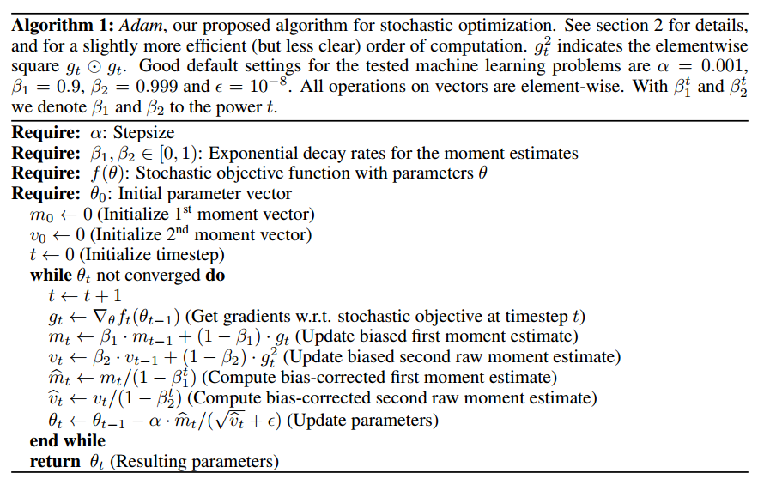
Adam
RMSProp + Momentum
for momentum
for RMSprop

